Slide 1
Spam Email Detection Using Various Machine Learning Algorithms
AMS 597 Machine Learning Algorithms Comparison Project
By: Denis O’Byrne <denis.obyrne@stonybrook.edu>

Slide 2
Learning Objectives
Learning Methods to Compare Different Machine Learning Classification Models
Understand the Machine Learning Algorithms Themselves to See How the Model is Chosen & the Classification of the Algorithms
Consideration on how to Tune Classification Algorithms

Slide 3
Algorithms to be Compared
Classification and Regression Trees (CART)
Random Forest
Neural Networking
Ridge Regression
Lasso Regression
Elastic Regression

Slide 4
Classification and Regression Trees (CART)
CART, originally known as Decision Tree Classification, attempts to Split Data
Into Groups based off Observed Features variables in data to separate positive and negative responses
At each split in the data, Decision Trees attempt to pick the attribute that will Minimize Overlap between the positive and negative responders
The Algorithm Recursively Splits the data until either all the data has been successfully separated, or the algorithm can no longer find ways to make improvements in both the specificity and sensitivity

Slide 5
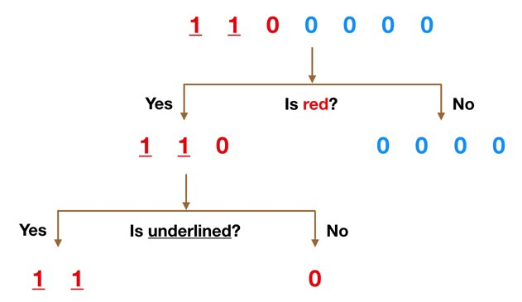
Example Decision Tree Using CART
In this tree, the Binary Observations represent Positive (1) and Negative (0) Observations in the Response Variable
Color and being Underlined are properties an observation may have
Source: https://towardsdatascience.com/understanding-random-forest-58381e0602d2
This Site also offers useful information on the next Algorithm

Slide 6
Random Forest, Decision Trees Made Better
Random Forest is an Expansion of the CART Algorithm in which, Multiple Decision Trees are formed using only a Random Subset of Features on each Tree
By randomizing the subsets we create Uncorrelated Models/Trees, which when Aggregated Together offer a Higher Probability of Correctly Classifying the observation than any one tree
On top of this observations for the trees to be trained on are Sampled with Replacement from the dataset to further ensure the trees are uncorrelated as they are formed on different datasets

Slide 7
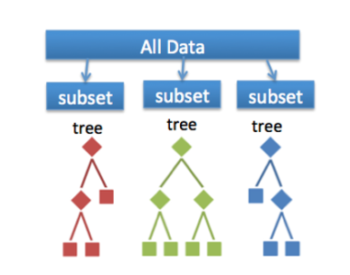
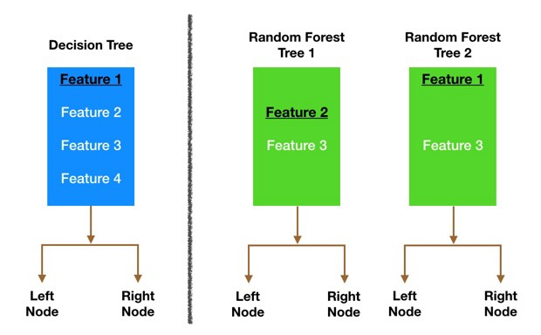
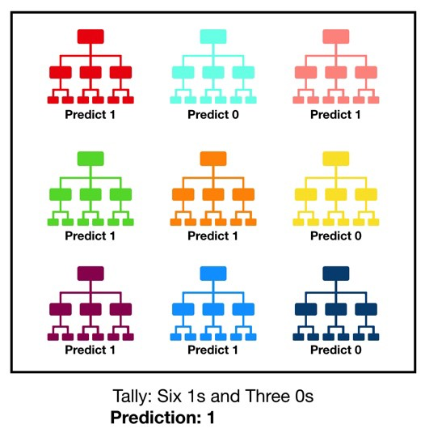
Decision Trees in Action
Figure 1: Randomize Training Data using Sampling with Replacement
Figure 2: Randomization of Features to Split Data With at Each Node For Each Tree
Figure 3: Aggregate Classification on All Trees to Form Prediction
Source Figure 1 Click Here
Source for Figures 2 and 3 Click Here

Slide 8
Neural Networks for Classification
Neural Networks attempt to Replicate Biological Learning to build a model
Each Neuron Represents a Function and computes a Score for Earlier Neurons to Evaluate their Contribution to the Classification of the response variable
Connections Between Neurons have a Weighting Functions to adjust the strength of each node to improve the accuracy of classification, neurons may also make use of a Threshold Function to Ignore an Input if it is Too Small to have significance on the output
The Network Learns by Adjusting the Weights on each connection After Observing New Training Data to reduce total errors
Training is Complete when Improvements made through observing a specified amount of data are No Longer Above a Desired Threshold

Slide 9
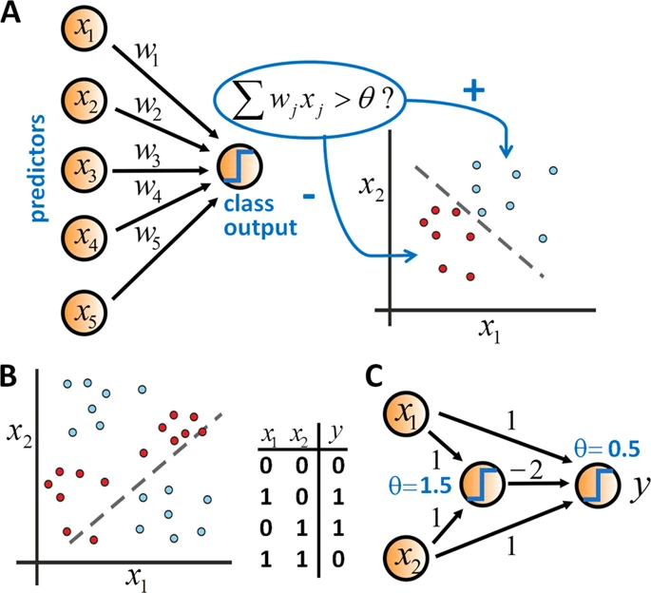
Example Neural Network
Neural Network with Weights and a threshold function with threshold θ. This threshold is plotted to show the cutoff for specific x1 and x2 example values are then plugged in
Neural Network Classifying an Image of a Dog By Analyzing Image Pixels
Image Source Here
Gif Source Click Here

Slide 10
Regularization L1 vs L2
Regularization is an attempt to Penalize Models though adding in bias for specific types if models in order to Mitigate Instability in OLS Regression
L1 Regularization adds a penalty λ1 equal to the magnitude of the coefficients thus limiting the size of the coefficients, in sometimes reducing them to 0, removing variables from the Regression equation entirely usually making a Sparse Model
Lasso Regression Uses L1 Regularization
L2 regularization adds a penalty λ2 equal to the square of the magnitude of coefficients. L2 will not yield sparse models and all coefficients are shrunk by the same factor (none are eliminated)
Ridge Regression Uses L2 Regularization
Elastic Net Regression Combines L1 & L2 Regularization

Slide 11


Ridge Regression (Tikhonov regularization)
Used to Mitigate Multicollinearity (MCL) amongst variables in OLS regression
In OLS the effect coefficients are calculated as:
Without MCL this is not an issue but
In the presence of MCL there are either multiple or no solutions for B due to an under-(or over)-determined system of equations
Under Ridge Regression we attempt to instead solve:
Which fixes the issues of MCL
Ridge Regression also makes use of L2 regularization

Slide 12
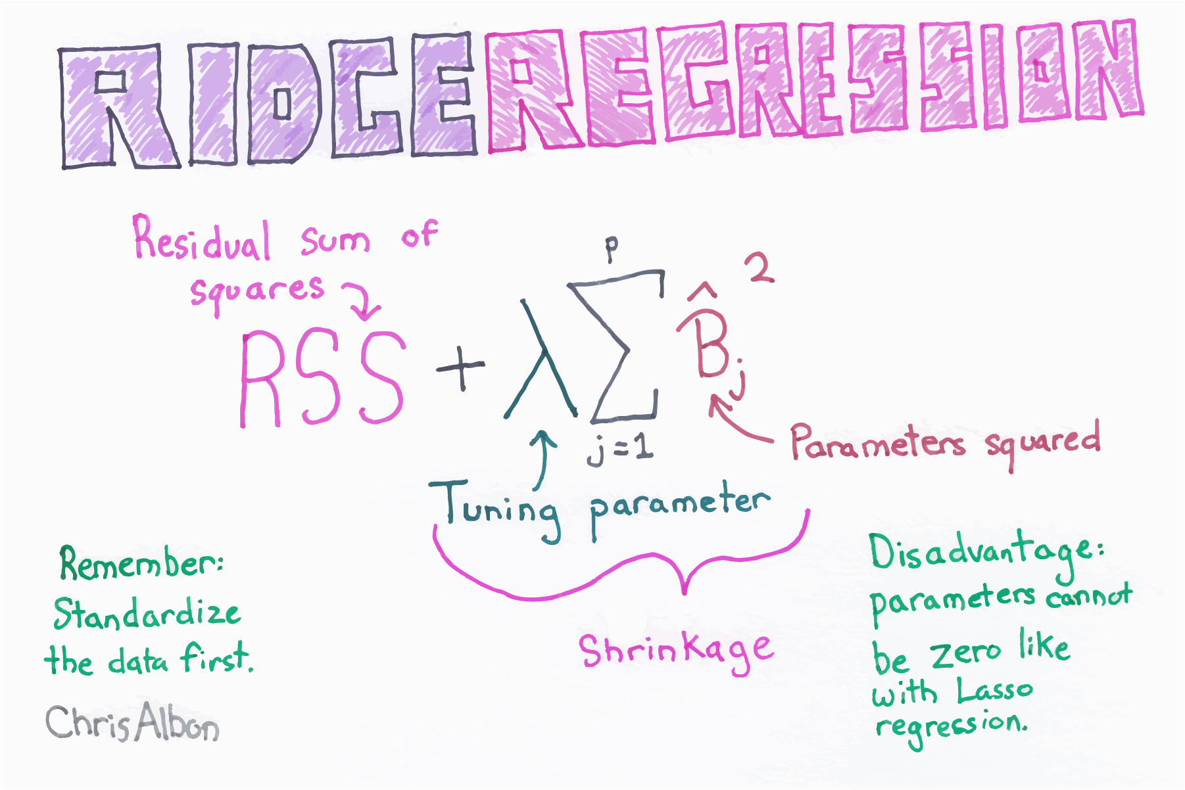
Source for Great Machine Learning Flash Cards

Slide 13
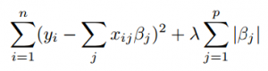
Least Absolute Shrinkage & Selection Operator (LASSO)
LASSO is useful for Variable Selection, as well as solving OLS with a Stable Solution
Mitigates Multicollinearity
Makes Use of L1 Regularization by minimizing the equation below:
If λ=0 then minimizing is equivalent to solving OLS equation

Slide 14
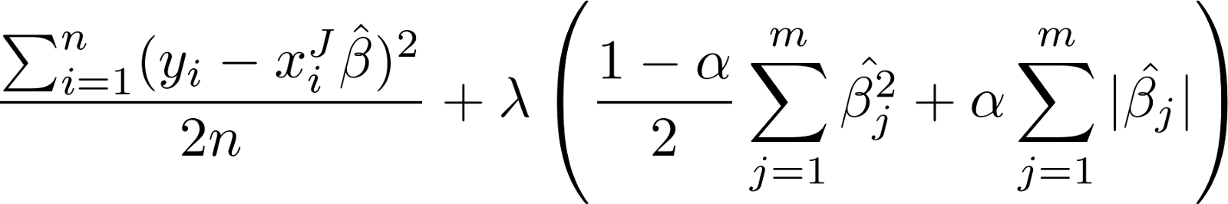
Elastic Net Regression
Elastic Net Regression is a combination of LASSO and Ridge Regression making use of L1 and L2 Regularization
Elastic Net Regression involves minimizing the following equation:

Slide 15
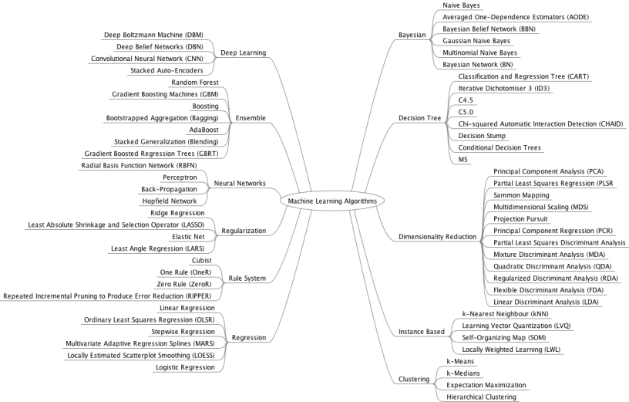
Image Source

Slide 16
Methods for Comparing Machine Learning Models
Kolmogorov-Smirnov Percentages (KS%)
ROC Plots & AUC Percentages
Gini Information Gain Index
Confusion Matrices

Slide 17
Kolmogorov-Smirnov Percentages (KS%)
K-S measures the ability of a model to separate positive and negative responses
K-S = |Cumulative % positive— Cumulative % negative|
In other words it is found as |Sensitivity - Specificity|
It is common to Plot the KS% as a function of the percentiles of expected probabilities for data to see how it performs at each cutoff value for classification

Slide 18
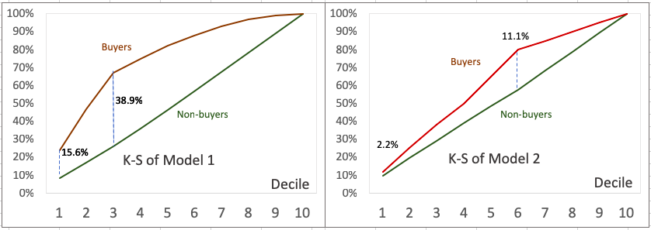
Example KS Plots
Below the KS is plotted as a function of the deciles for predicted probabilities to compare 2 models on the same data to classify Buyers vs Non-buyers
Model 1 out performs Model 2 at all cutoffs and has a higher maximum separation percentage
Source Click Here

Slide 19
ROC Plots & AUC Percentages
Receiver Operating Characteristic (ROC) curves, plot the Sensitivity vs False Positive Rate of a model to find the cutoff probability for classification that minimizes the desired attributes of the model
Model Accuracy is maximized by the point on the curve closest to the point (1,1)
The Area Under the Curve (AUC) is a measure of the overall goodness of fit of the model as a percentage
AUC = 1 if at all cutoff levels for classification the model correctly classifies all observations

Slide 20
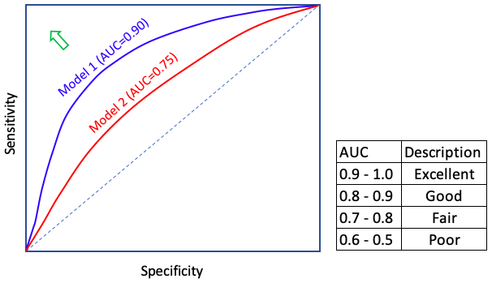
Example ROC Plots & AUC Percentages
ROC curves can be plotted side by side to show which model performs the best for classifying the data at different cutoffs, a higher AUC represents a stronger model
The accuracy a model is maximized by choosing the point on the curve closest to the point (0 ,1) as indicated by the Arrow
Using same Buyer vs non-buyer Models as Before from KS Plots
Model 1 clearly outperforms Model 2
Image Source Click here

Slide 21
Gini Coefficient
The Gini Coefficient commonly used in Economics and Credit Score Models is a measure of the ability of the model to properly classify the data
It measures the strength of the model versus random classification of the data
Gini = 2*AUC - 1
Gini coefficient an is equivalent measure to the AUC, not necessary to calculate both but I have shown it for all models

Slide 22
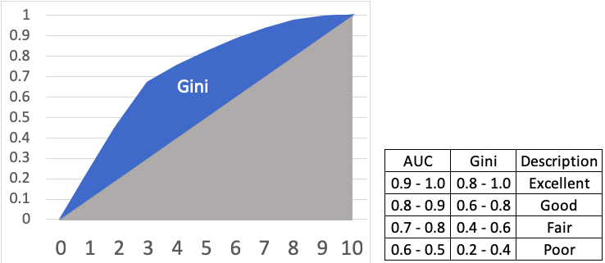
Gini Coefficient and ROC Plot
Here Gini Coefficient is plotted as a function of the classification cutoff probability as a decile
Source Click Here

Slide 23
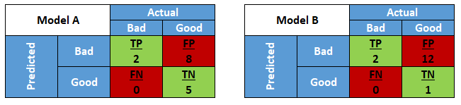
Confusion Matrix
Confusion Matrices count the actual numbers of observations in each type of classification, True Negatives, False Negatives, True Positives and False Positives
With a Confusion Matrix, the Specificity, Sensitivity and Accuracy can easily be calculated
Example: Confusion Matrices to compare 2 Models
Source Click Here

Slide 24
Applying Techniques in R
To provide analytical comparisons for the aforementioned Machine Learning Algorithms, each model will be developed on the same dataset through split into a testing and training set for Cross Validation of results.
The dataset used for Analysis is the Spam Email Dataset provided by the UCI Machine Learning Repository
All analysis will be done using R and all code with outputs is provided in a link to my published copy on Google Drive on the Final Slide

Slide 25
Spam Dataset Overview
57 Continuous Independent Variables
1 Binary Response Variable indicating if the Email is Spam or Not
Observations with Missing Values are removed
4601 Observations analyzed
Attempting to form a model to predict for spam
Would prefer higher Specificity Percentage in final model so that Real Emails are not marked as Spam

Slide 26
Data Splitting
Data was split into Testing and Training Subsets
75% of the observations used to Train Models
All forms of model accuracy validation are checked to see how the model performs on the Training and Testing Sets
Deviance in all measurements between the two sets is measured for each model

Slide 27
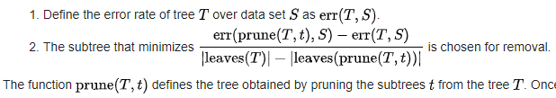
CART Training
For all decision trees, the Algorithm is first applied to all data in the Training set
To avoid overfitting the Tree is “pruned” to the remove excessive splitting
Pruning is done by analyzing the cost complexity (CP) and finding the minimum number of splits required to attain the minimum CP
The appropriate cutoff is found via a CP vs Error Rate Plot

Slide 28
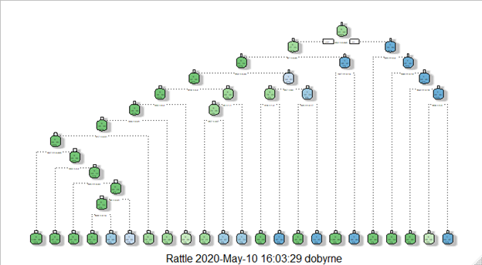
Cart Unpruned Tree
Here we can see there are 22 node splits in the Full Model Decision Tree for the Training Data, which is very high complexity
Cart Full Decision Tree Spam Training Data

Slide 29
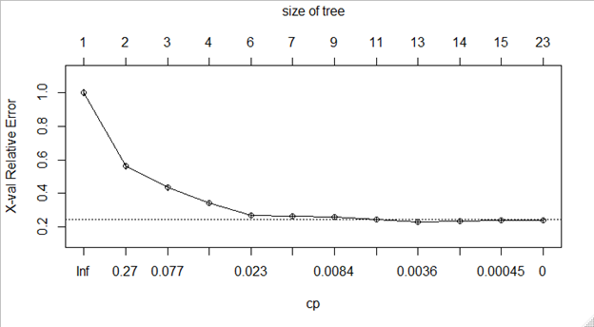
CP vs Error Rate Plot
Here we can see the model reaches the lowest error rate at a CP = 0.0036 which occurs at 13 nodes meaning we should prune the tree by limiting CP to 0.0035

Slide 30
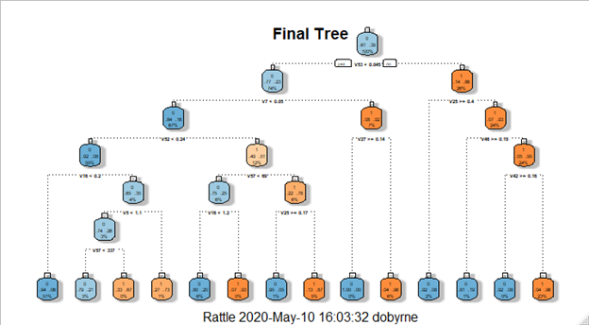
Final Pruned Tree
Now the tree is successfully pruned
Lets run the analysis

Slide 31
CART Training KS
To calculate the KS we use the AUC curve plotted on the next page to find the point which maximizes the difference between the True Positive Rate and the False Positive Rate, this is the point closest to (0,1)
> KSCartTrain = Max( Roc Y- value - X- Value)
[1] 0.8313008

Slide 32
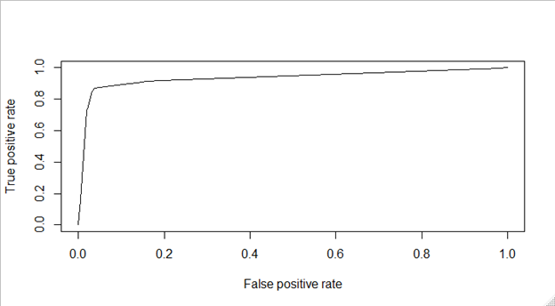
CART Training ROC Plot, AUC, KS and Gini
Here we can see the model is quite strong with an AUC score of
> aucCartTrain
[1] 0.9357564
Gini Coefficient
2AUC-1 = 0.8715128
ROC Plot CART Model Training Data
Area Under Curve
0.9357564
Optimal Cutoff with KS = 0.8313008

Slide 33
CART Training Data Confusion Matrix
Spam Training Data CART Method using Best Accuracy Cutoff |  | Predicted Value
 |  | Normal Email | Spam
Observed Result | Normal Email | 2015 | 76
 | Spam | 180 | 1180
TNR = Specificity = 2015/(2015+76) = 0.96365375418
FPR = 1- Specificity = 76/(2015+76) = 0.03634624581
TPR = Sensitivity = 1180/(180+1180) = 0.86764705882
KS = TPR - FPR = 0.83130081301
Accuracy = (2015+1180)/(2015+76+180+1180) = 0.9258186033

Slide 34
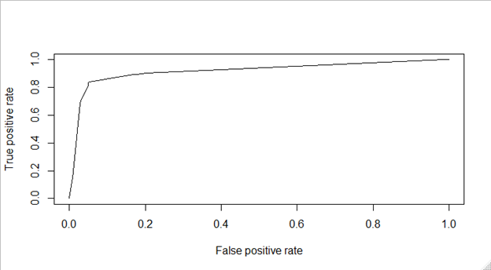
CART ROC Curve Testing Data
ROC Plot CART Model Testing Data
AUC = 0.9177126
Gini = 0.8354252
Optimal Cutoff with KS = 0.787975

Slide 35
CART Testing Data Confusion Matrix
Spam Training Data CART Method using Best Accuracy Cutoff |  | Predicted Value
 |  | Normal Email | Spam
Observed Result | Normal Email | 660 | 37
 | Spam | 72 | 381
TNR = Specificity = 660/(660+37) = 0.9469153515
FPR = 1- Specificity = 37/(660+37) = 0.05308464849
TPR = Sensitivity = 381/(72+381) = 0.84105960264
KS = TPR - FPR = 0.78797495415
Accuracy = (660+381)/(660+37+72+381) = 0.9052173913

Slide 36
CART
Deviation in Values Between Training & Testing
Measure | Training Set | Testing Set | Difference | Percent Change
KS | 0.83130081301 | 0.78797495415 | -0.04332585886 | -5.2118%
AUC | 0.9357564 | 0.9177126 | -0.0180438 | -1.928%
Gini | 0.8715128 | 0.8354252 | -0.0360876 | -4.1408%
Accuracy | 0.9258186033 | 0.9052173913 | -0.020601212 | -2.225%
Sensitivity | 0.86764705882 | 0.84105960264 | -0.02658745618 | -3.064%
Specificity | 0.96365375418 | 0.9469153515 | -0.01673840268 | -1.737%

Slide 37
Random Forest (RF) Analysis
For The RF Analysis, we can view the importance of the individual variables in the classification process
The importance can be shown as the decrease in classification accuracy or decrease in Node Gini (Gini Impurity not the same as Gini Coefficient) via removing that variable from selection process for all Random Trees
RF Trees, like regular decision trees can be pruned via analyzing the OOB (out of bag) error rate as a function of total number of nodes
OOB Error is the mean accuracy of the RF to Classify observations using all trees in which that observation was not used for development of the tree

Slide 38
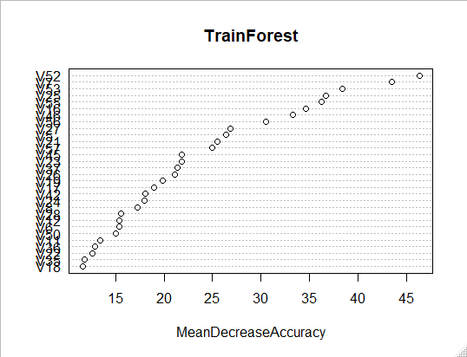
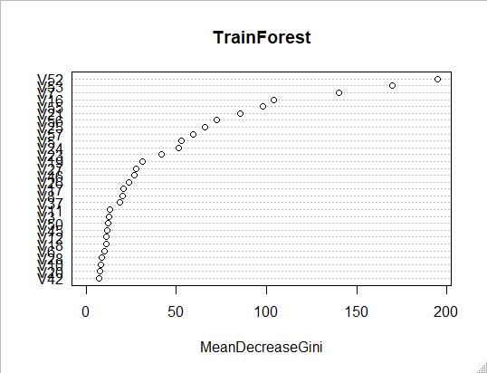
Plots of Importance of Variables
Most important Variables are listed from Top to bottom, the more important a variable is for classification, the farther right its plot point becomes

Slide 39
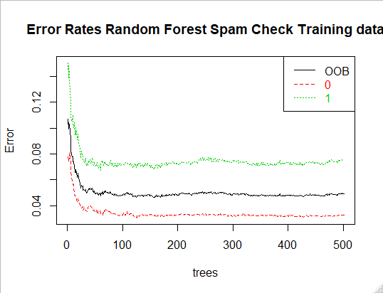
Plot of OOB Error Rates for Generated RF
Here we can see the Total OOB Error plotted in black
False Positive OOB Error is Plotted in Red
and
False Negative Error in Green

Slide 40
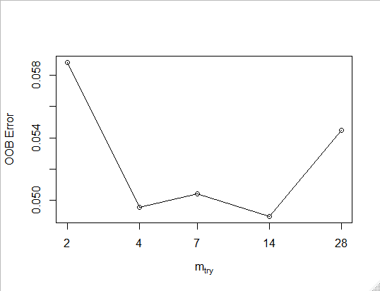
Best Number of Variables Per Tree
Here we can see the OOB Error rate Plotted as a function of the number of variables to split on per tree
Best Choice for Variables per Tree is 14
OOB Error Rate as a Function of Number Variable Choices Per Random Forest Tree

Slide 41
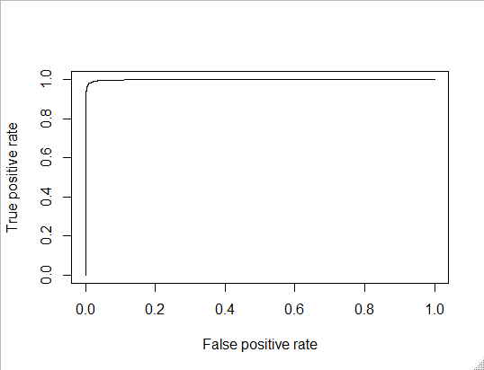
Training Set ROC Curve Random Forest
We can see that as expected, by aggregating multiple decision trees, the Wisdom of the Crowd has improved our model over that found in CART with a much higher AUC
Training Set ROC Curve Random Forest
AUC = 0.9988522
Gini = 0.9977044
Optimal Cutoff with KS = 0.9710964

Slide 42
Random Forest Confusion Matrix
Spam Training Data RF Method using Best Accuracy Cutoff |  | Predicted Value
 |  | Normal Email | Spam
Observed Result | Normal Email | 2076 | 15
 | Spam | 33 | 1327
TNR = Specificity = 2076/(15+2076) = 0.99282639885
FPR = 1- Specificity = 15/(2076+15) = 0.00717360114
TPR = Sensitivity = 1327/(33+1327) = 0.97573529411
Accuracy = (2076+1327)/(2076+15+33+1327) = 0.98609098811

Slide 43
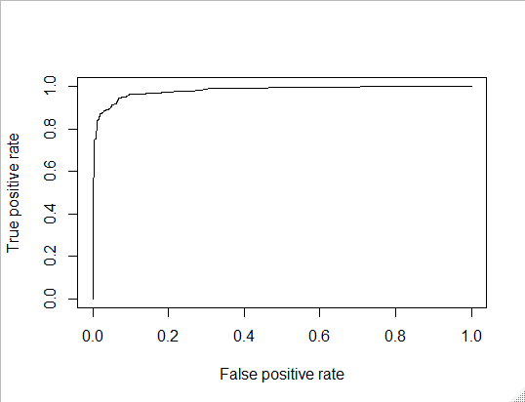
Random Forest ROC Curve Testing Data
Due to minimizing OOB Errors we minimized errors on new data, making the AUC great on the testing set
Testing set ROC Curve
AUC = 0.97948
Gini = 0.95896
Optimal Cutoff with KS = 0.87396

Slide 44
Random Forest Testing Data Confusion Matrix
Spam Testing Data Random Forest Method using Best Accuracy Cutoff |  | Predicted Value
 |  | Normal Email | Spam
Observed Result | Normal Email | 668 | 29
 | Spam | 47 | 406
TNR = Specificity = 668/(668+29) = 0.958393113
FPR = 1- Specificity = 29/(668+29) = 0.041607
TPR = Sensitivity = 406/(47+406) =0.896247
Accuracy = (668+406)/(668+29+47+406) = 0.93391304347

Slide 45
Random Forest
Deviation in Values Between Training & Testing
Measure | Training Set | Testing Set | Difference | Percent Change
KS | 0.9710964 | 0.87396 | -0.09714 | -10.003%
AUC | 0.9988522 | 0.97948 | -0.01937 | -1.939%
Gini | 0.97948 | 0.95896 | -0.02052 | -2.095%
Accuracy | 0.98609098811 | 0.93391304347 | -0.05218 | -5.291%
Sensitivity | 0.97573529411 | 0.896247 | -0.07949 | -8.147%
Specificity | 0.99282639885 | 0.958393113 | -0.03443 | -3.468%
In total accuracy this is the best model, but not for retention of accuracy on new data, that goes to the Regularization Algorithms

Slide 46
Neural Network Analysis
A neural network will be computed and analysis will be run as usual with no required work by us to ensure accuracy of the model unlike in CART and RF as we do not need to prune any trees
In order to create the Neural Network it should be noted that the inputs, ie the observations for the independent variables will need to be scaled to normalize the input vectors
For a Neural Network to become accurate it usually requires many more training observations than other models, however the upper limit on accuracy is usually much higher
Note that the functions used for producing output at each node are unknown to the user and thus Neural Nets provide no understanding of the model for the user only for the computer

Slide 47
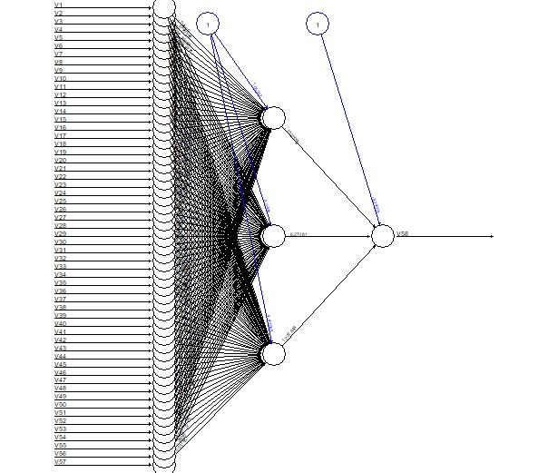
Neural Network for Spam Training Data

Slide 48

Training Set ROC Plot for Neural Network
This ROC Plot indicates the Neural Network out performs the CART Model but not the RF model on the Training Set
Training Set Neural Network ROC Plot
AUC = 0.9855913
Gini = 0.9711826
Optimal Cutoff with KS = 0.9452056

Slide 49
Neural Network Training Confusion Matrix
Spam Training Data Neural Network Method using Best Accuracy Cutoff |  | Predicted Value
 |  | Normal Email | Spam
Observed Result | Normal Email | 2043 | 48
 | Spam | 44 | 1316
TNR = Specificity = 2043/(48+2043) = 0.97704447632
TPR = Sensitivity = 1316/(44+1316) = 0.96764705882
Accuracy = (2043+1316)/(2043+48+44+1316) = 0.97334106056

Slide 50
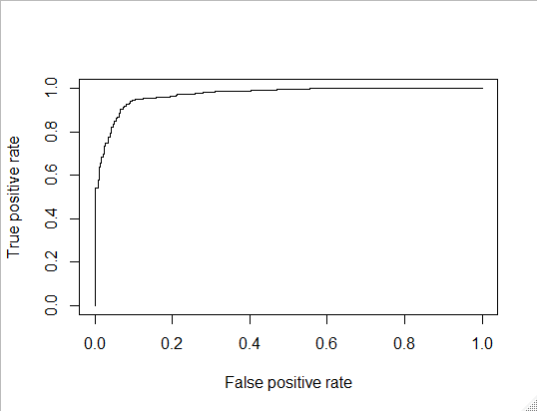
Testing Set ROC Curve Neural Network
Testing set ROC Curve Neural Network
We can see that as expected, by aggregating multiple decision trees, the Wisdom of the Crowd has improved our model over that found in CART with a much higher AUC
AUC = 0.9698519
Gini = 0.9397038
Optimal Cutoff with KS = 0.8478025

Slide 51
Neural Network Testing Confusion Matrix
Spam Testing Data Neural Network Method using Best Accuracy Cutoff |  | Predicted Value
 |  | Normal Email | Spam
Observed Result | Normal Email | 619 | 78
 | Spam | 24 | 429
TNR = Specificity = 619/(619+78) = 0.88809182209
TPR = Sensitivity = 429/(24+429) = 0.94701986755
Accuracy = (619+429)/(619+78+24+429) = 0.91130434782

Slide 52
Neural Net
Deviation in Values Between Training & Testing
Measure | Training Set | Testing Set | Difference | Percent Change
KS | 0.9452056 | 0.8478025 | -0.0974031 | -10.305%
AUC | 0.9855913 | 0.9698519 | -0.0157394 | -1.597%
Gini | 0.9711826 | 0.9397038 | -0.0314788 | -3.241%
Accuracy | 0.97334106056 | 0.91130434782 | -0.06203671274 | -6.374%
Sensitivity | 0.96764705882 | 0.94701986755 | -0.02062719127 | -2.132%
Specificity | 0.97704447632 | 0.88809182209 | -0.08895265423 | -9.104%

Slide 53
Ridge Regression Analysis
Under Ridge regression none of the variables are removed from the model
Ridge models suffer from excessive complexity and often result in over-fitting
To Maximize Accuracy the Complexity parameter coefficient λ must be tuned to the correct value to find the most effective model

Slide 54
Ridge Regression Coefficients
> coef(model)
58 x 1 sparse Matrix of class "dgCMatrix"
s0
(Intercept) 1.971755e-01
V1 -4.410549e-02
V2 -1.084092e-02
V3 3.938390e-02
V4 1.382867e-02
V5 8.660355e-02
V6 1.147219e-01
V7 2.030488e-01
V8 8.176332e-02
V9 5.524125e-02
V10 1.927852e-02
V11 8.075606e-02
V12 -2.819011e-02
V13 2.892186e-03
V14 1.299994e-02
V15 3.272739e-02
V16 7.743159e-02
V17 5.568887e-02
V18 6.589712e-02
V19 1.204670e-02
V20 6.202266e-02
V21 4.860907e-02
V22 4.432062e-02
V23 1.806713e-01
V24 9.544106e-02
V25 -1.932691e-02
V26 -2.816953e-02
V27 -1.113688e-02
V28 2.401157e-03
V29 -7.136899e-03
V30 -5.485631e-02
V31 -1.903419e-02
V32 1.656088e-02
V33 -3.914051e-02
V34 2.274148e-02
V35 -2.565966e-02
V36 4.072499e-02
V37 -2.904225e-02
V38 -5.861309e-02
V39 -1.396887e-02
V40 3.324887e-02
V41 -7.177855e-03
V42 -3.451984e-02
V43 -5.295559e-02
V44 -3.249018e-02
V45 -3.567751e-02
V46 -3.535544e-02
V47 -1.693993e-01
V48 -5.503535e-02
V49 -1.307405e-01
V50 -5.051641e-02
V51 -5.821501e-02
V52 6.169676e-02
V53 2.629115e-01
V54 4.030569e-02
V55 3.497221e-04
V56 4.574202e-05
V57 7.145715e-05
As can be seen Ridge models never remove any variables making the model suffer from extreme complexity and as such often suffers from overfitting

Slide 55
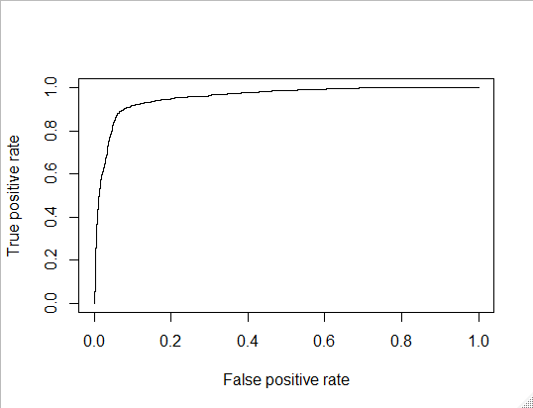
Ridge Regression Training ROC Curve
Training set ROC Curve Ridge Model
We can see our Ridge model does pretty well on the Training set
AUC = 0.9566074
Gini = 0.9132149
Optimal Cutoff with KS = 0.8247669

Slide 56
Ridge Regression Training Confusion Matrix
Spam Training Data Ridge Method using Best Accuracy Cutoff |  | Predicted Value
 |  | Normal Email | Spam
Observed Result | Normal Email | 2003 | 88
 | Spam | 298 | 1062
TNR = Specificity = 2003/(88+2003) = 0.95791487326
TPR = Sensitivity = 1062/(298+1062) = 0.78088235294
Accuracy = (2003+1062)/(2003+88+298+1062) = 0.88814836279

Slide 57

Ridge Regression Testing ROC Curve
Testing set ROC Curve Ridge Model
Surprisingly our model avoided over fitting and remained quite accurate on the training set
AUC = 0.949807
Gini = 0.8996139
Optimal Cutoff with KS = 0.8133629

Slide 58
Ridge Regression Testing Confusion Matrix
Spam Testing Data Ridge Method using Best Accuracy Cutoff |  | Predicted Value
 |  | Normal Email | Spam
Observed Result | Normal Email | 664 | 33
 | Spam | 111 | 342
TNR = Specificity = 664/(664+33) = 0.95265423242
TPR = Sensitivity = 342/(342+111) = 0.75496688741
Accuracy = (664+342)/(342+664+111+33) = 0.87478260869

Slide 59
Ridge Regression
Deviation in Values Between Training & Testing
Measure | Training Set | Testing Set | Difference | Percent Change
KS | 0.8247669 | 0.8133629 | -0.011404 | -1.383%
AUC | 0.9566074 | 0.949807 | -0.0068004 | -0.711%
Gini | 0.9132149 | 0.8996139 | -0.013601 | -1.489%
Accuracy | 0.88814836279 | 0.87478260869 | -0.0133657541 | -1.505%
Sensitivity | 0.78088235294 | 0.75496688741 | -0.02591546553 | -3.319%
Specificity | 0.95791487326 | 0.95265423242 | -0.00526064084 | -0.549%

Slide 60
LASSO Regression Analysis
For Lasso Regression we can expect to have less variables in our final model
Because of this our model will be less susceptible to over-fitting
Accuracy on training set should be about the same as that under Ridge but is usually lower in practice
Again Complexity Parameter is tuned to ensure best model is found

Slide 61
LASSO Regression Coefficients
> coef(modelLasso)
(Intercept) 1.694570e-01
V1 .
V2 .
V3 2.646345e-02
V4 2.469212e-03
V5 7.574690e-02
V6 9.851368e-02
V7 2.064486e-01
V8 6.694576e-02
V9 4.550987e-02
V10 3.523540e-03
V11 3.568047e-02
V12 -2.932034e-03
V13 .
V14 .
V15 8.581696e-03
V33 -1.646864e-02
V34 .
V35 .
V36 .
V37 -2.491339e-02
V38 .
V39 .
V40 .
V41 .
V42 -2.327309e-02
V43 -1.949405e-03
V44 -7.319002e-03
V45 -2.149988e-02
V46 -1.904595e-02
V47 .
V48 -3.985672e-03
V49 -1.980517e-02
V16 7.169426e-02
V17 5.117134e-02
V18 5.420117e-02
V19 1.119052e-02
V20 5.092191e-02
V21 5.442054e-02
V22 2.298036e-02
V23 1.857776e-01
V24 7.529452e-02
V25 -1.603832e-02
V26 -2.704336e-02
V27 -6.029602e-03
V28 .
V29 .
V30 -5.069327e-03
V31 .
V32 .
V50 .
V51 .
V52 5.202562e-02
V53 2.552507e-01
V54 .
V55 9.953901e-05
V56 4.311752e-06
V57 7.275816e-05
As can be seen, many of the coefficients have become 0, making the model much less complex than that for Ridge Regression
Thus
We can expect more stability in accuracy on new data

Slide 62
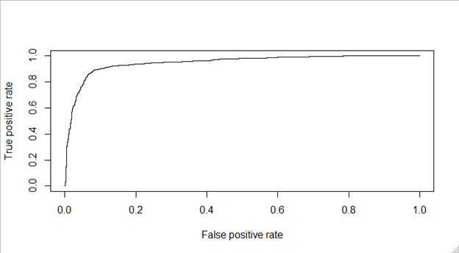
LASSO Regression Training ROC Curve
Overall this model is less accurate than the Ridge Model as the AUC, Gini and KS are all lower than the Testing and Training values for the Ridge Model
Training set ROC Curve LASSO Model
AUC = 0.9484921
Gini = 0.8969843
Optimal Cutoff with KS = 0.8101686

Slide 63
LASSO Regression Training Confusion Matrix
Spam Training Data LASSO Method using Best Accuracy Cutoff |  | Predicted Value
 |  | Normal Email | Spam
Observed Result | Normal Email | 2006 | 85
 | Spam | 372 | 988
TNR = Specificity = 2006/(85+2006) = 0.95934959349
TPR = Sensitivity = 988/(988+372) = 0.72647058823
Accuracy = (2006+988)/(2006+85+372+988) = 0.86757461605

Slide 64
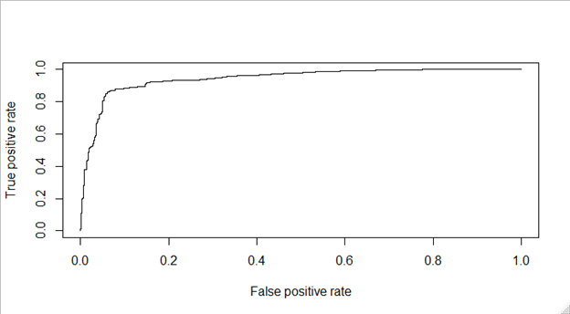
LASSO Regression Testing ROC Curve
This looks very similar to our Training data ROC plot which satisfies our hypothesis of stability in accuracy due to reduced complexity
Testing set ROC Curve LASSO Model
AUC = 0.9432731
Gini = 0.8865463
Optimal Cutoff with KS = 0.8016634

Slide 65
LASSO Regression Testing Confusion Matrix
Spam Testing Data LASSO Method using Best Accuracy Cutoff |  | Predicted Value
 |  | Normal Email | Spam
Observed Result | Normal Email | 668 | 29
 | Spam | 139 | 314
TNR = Specificity = 668/(29+668) =0.95839311334
TPR = Sensitivity = 314/(139+314) = 0.69315673289
Accuracy = (668+314)/(668+29+314+139) = 0.85391304347

Slide 66
LASSO
Deviation in Values Between Training & Testing
Measure | Training Set | Testing Set | Difference | Percent Change
KS | 0.8101686 | 0.8016634 | -0.0085052 | -1.050%
AUC | 0.9484921 | 0.9432731 | -0.005219 | -0.550%
Gini | 0.8969843 | 0.8865463 | -0.010438 | -1.164%
Accuracy | 0.86757461605 | 0.85391304347 | -0.01366157258 | -1.575%
Sensitivity | 0.72647058823 | 0.69315673289 | -0.03331385534 | -4.586%
Specificity | 0.95934959349 | 0.95839311334 | -0.00095648015 | -0.100%
Note that in all cases except Sensitivity the difference between the testing and training scores are lower for the Lasso Model than the Ridge model this is also true for most percent changes meaning Lasso performs slightly more consistently on new data, while Ridge formed a noticeably stronger model on both sets

Slide 67
Elastic Net Regression Analysis
Elastic net Regression combines the L1 and L2 regularization of Ridge and Lasso Regressions
Elastic Net still deletes variables but less often than Lasso, so that collinear terms may still be used together if they enhance the model usefully
Elastic net should therefore compete with Lasso for consistency on new data, and compete for accuracy with Ridge

Slide 68
Elastic Net Regression Coefficients
(Intercept) 1.938937e-01
V1 -3.835883e-02
V2 -9.660748e-03
V3 3.826396e-02
V4 1.317511e-02
V5 8.672183e-02
V6 1.142050e-01
V7 2.050381e-01
V8 8.135512e-02
V9 5.406347e-02
V10 1.813894e-02
V11 7.659150e-02
V12 -2.717604e-02
V13 4.723989e-04
V14 1.014232e-02
V15 3.087271e-02
V16 7.755782e-02
V17 5.503823e-02
V18 6.524567e-02
V19 1.196415e-02
V20 6.175695e-02
V21 4.930904e-02
V22 4.366139e-02
V23 1.821074e-01
V24 9.455426e-02
V25 -1.907207e-02
V26 -2.773926e-02
V27 -1.079688e-02
V28 .
V29 -3.412095e-03
V30 -4.899441e-02
V31 -7.917650e-03
V32 4.057662e-03
V33 -3.812047e-02
V34 1.785345e-02
V35 -2.221258e-02
V36 3.470234e-02
V37 -2.910006e-02
V38 -5.229032e-02
V39 -1.256091e-02
V40 2.863450e-02
V41 -5.746846e-03
V42 -3.509411e-02
V43 -4.853578e-02
V44 -3.110064e-02
V45 -3.495506e-02
V46 -3.457435e-02
V47 -1.546562e-01
V48 -5.166523e-02
V49 -1.259371e-01
V50 -4.214202e-02
V51 -4.963658e-02
V52 6.159358e-02
V53 2.645728e-01
V54 3.646698e-02
V55 3.417223e-04
V56 3.736002e-05
V57 7.257684e-05
We can see that only one variable was removed which is far less than that of Lasso, lets see how that changes the outcomes

Slide 69

Elastic Net Regression Training ROC Curve
Note high accuracy of model close to range of Ridge Regression
Training set ROC Curve Elastic Model
AUC = 0.9563149
Gini = 0.9126298
Optimal Cutoff with KS = 0.826644

Slide 70
Elastic Net Regression Training Confusion Matrix
Spam Training Data Elastic Net Method using Best Accuracy Cutoff |  | Predicted Value
 |  | Normal Email | Spam
Observed Result | Normal Email | 2003 | 88
 | Spam | 302 | 1058
TNR = Specificity = 2003/(88+2003) = 0.95791487326
TPR = Sensitivity = 1058/(1058+302) = 0.77794117647
Accuracy = (2003+1058)/(2003+88+302+1058) = 0.88698927847

Slide 71

Elastic Net Regression Testing ROC Curve
Testing set ROC Curve Elastic Model
Note that the curve looks very similar to before with very small decrease in accuracy like Lasso had
AUC = 0.9497151
Gini = 0.8994302
Optimal Cutoff with KS = 0.8133629

Slide 72
Elastic Net Regression Testing Confusion Matrix
Spam Testing Data Elastic Net Method using Best Accuracy Cutoff |  | Predicted Value
 |  | Normal Email | Spam
Observed Result | Normal Email | 664 | 33
 | Spam | 116 | 337
TNR = Specificity = 664/(33+664) =0.95265423242
TPR = Sensitivity = 337/(116+337) = 0.74392935982
Accuracy = (664+337)/(664+33+337+116) = 0.8704347826

Slide 73
Elastic Net
Deviation in Values Between Training & Testing
Measure | Training Set | Testing Set | Difference | Percent Change
KS | 0.826644 | 0.8133629 | -0.0132811 | -1.607%
AUC | 0.9563149 | 0.9497151 | -0.0065998 | -0.690%
Gini | 0.9126298 | 0.8994302 | -0.0131996 | -1.446%
Accuracy | 0.88698927847 | 0.8704347826 | -0.01655449587 | -1.866%
Sensitivity | 0.77794117647 | 0.74392935982 | -0.03401181665 | -4.372%
Specificity | 0.95791487326 | 0.95265423242 | -0.00526064084 | -0.549%
Note that in most measures Elastic net is between Lasso and Ridge for retention of Accuracy and the overall fit is strong like Ridge Regression

Slide 74
So how did the models compare
Ranking in order of Retention of Accuracy level on New Data
LASSO
Elastic Net
Ridge Regression
Random Forest
CART
Neural Network
Regularization Algorithms make use of the continuity of the independent RVs This reduces standard deviation in classification because the total information known about the distributions of the variables is greater as opposed to classifying all variables categorically in a decision tree
Overall the differences between the deviances of all models are still very small and all perform quite well on new data

Slide 75
Model Comparisons (Continued)
Comparing Total Accuracy on Testing and Training Data, the rankings are:
Random Forest (CLEAR WINNER)
Neural Net
CART
Ridge Regression
Elastic Net
LASSO
Model | Accuracy Training | Accuracy Testing
RF | 98.6% | 93.39%
NN | 97% | 91%
CART | 92% | 90.5%
RR | 88% | 87.5%
EN | 88% | 87.0%
LASSO | 86% | 85%
Regression Algorithms are not nearly as good at classification as classification algorithms obviously
Comparing AUCs for each model will result in an equivalently sorted list for the algorithms

Slide 76
What did we learn?
There are many useful methods specific to each algorithm to tune the classification cutoff for maximal results
Random Forest is the Pinnacle of Classification Algorithms as it aggregates over multiple sub models to mitigate randomness
Random Forest is also very strong on new data because Cross Validation via reduction in OOB Errors is embedded in the algorithm
The ROC Plot and Confusion Matrices are necessities when attempting to find the optimal classification model
Neural Nets can offer very strong models but require large Training sets to reach optimal accuracy as the Network needs to

Slide 77
Source Code And Link To Data Set
My Code can be found here with output included in Google Docs:
Denis O'Byrne Machine Learning Algorithms Comparisons R Code with Output
Runnable Version Of My Code
Data set source:
http://archive.ics.uci.edu/ml/datasets/spambase

